Slide 1
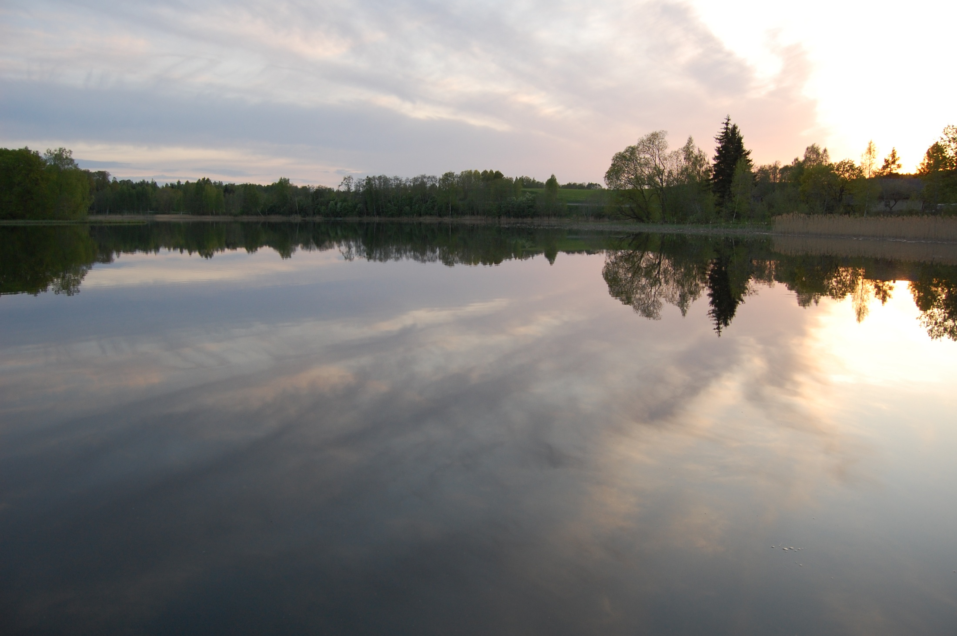
Quiz about Estonia
Erasmus
art@creativity

Slide 2
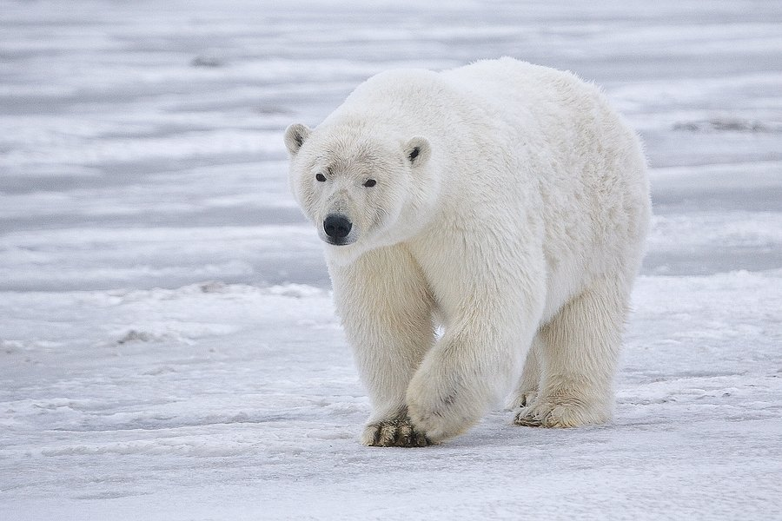
1. Do polar bears live in Estonian forests?
Yes!
No!

Slide 3
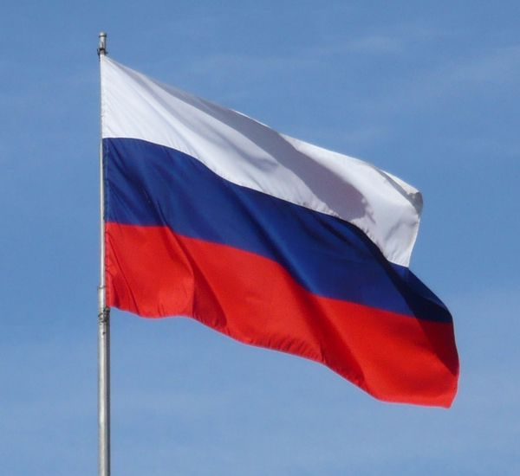
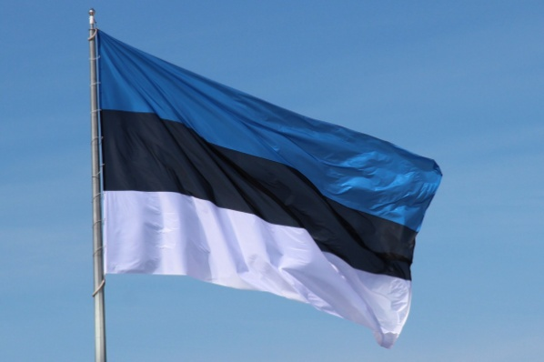
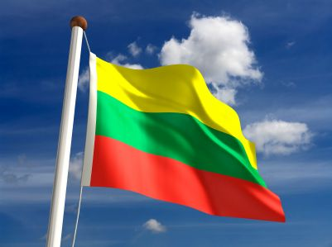
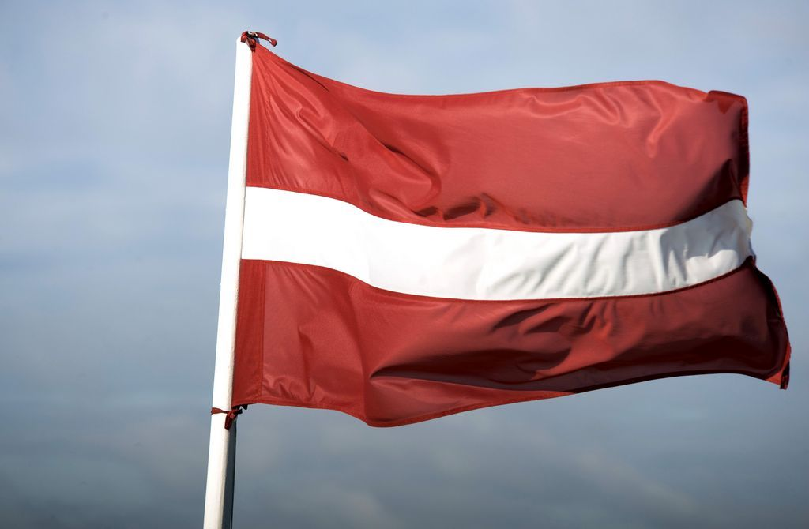
2. Which is Estonial national flag?
A.
B.
D.
C.

Slide 4
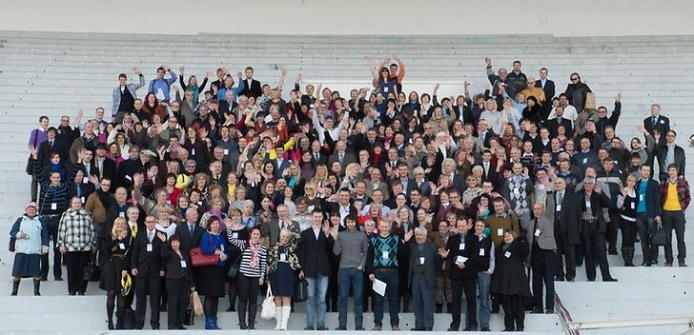
3. Population of Estonia is…….
A. 11,3 mil
C. 111,3 mil
B. 1,3 mil

Slide 5
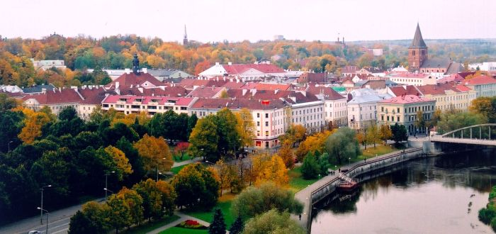
4. Pick up Estonian towns.
1. Helsinki
3. Salmela
2. Tartu
5. Narva
4. Pärnu

Slide 6
5. In 2014, the U.S. news site The Huffington Post highlighted 14 of the most “Over-The-Top” Christmas trees from around the world and a tree made of recycled wood from Estonia was among them. The tree symbolizes an innovative approach, modern responsible recycling and nature conservation. In which Estonian city was the Christmas tree located?
The link for finding the answer:
http://www.huffingtonpost.com/2014/12/06/amazing-christmas-trees-2014_n_6262224.html

Slide 7
6. Who was the most performed living composer in the world for the fourth year in a row, according to Bachtrack, the world's largest classical music event database in Great Britain? This composer celebrated his 80th birthday on September 11, 2015.
The link for finding the answer:
http://bachtrack.com/top-ten-statistics-classical-music-2014

Slide 8
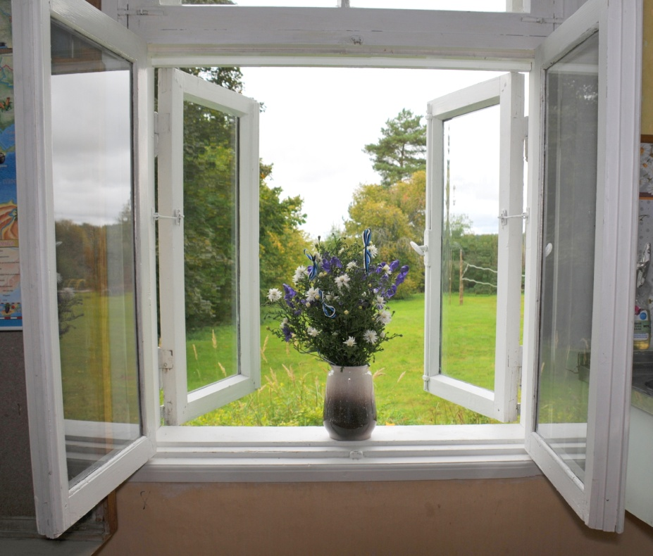
7.Where is situated our commune Kambja and our school if to seach for it in Tallinn?
1.North
2. East
3. South
3. South-east
4. West
5. South-west

Slide 9
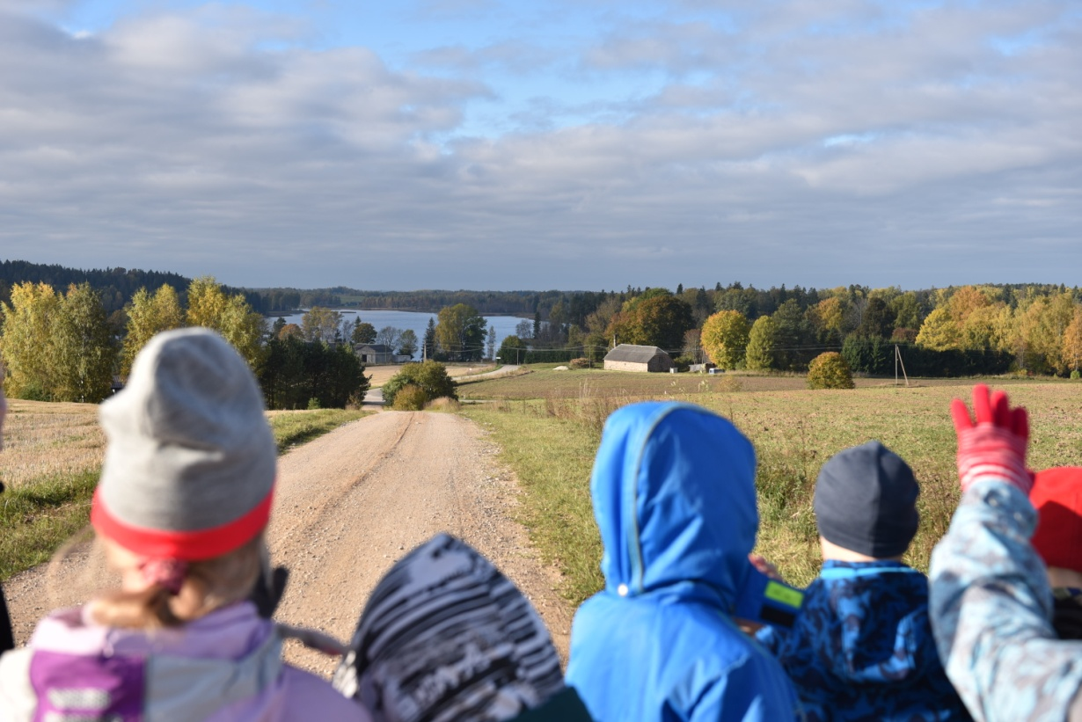
8. How many pupils are there in Unipiha school this year?
A. 18
B. 28
C. 108
D. 88

Slide 10
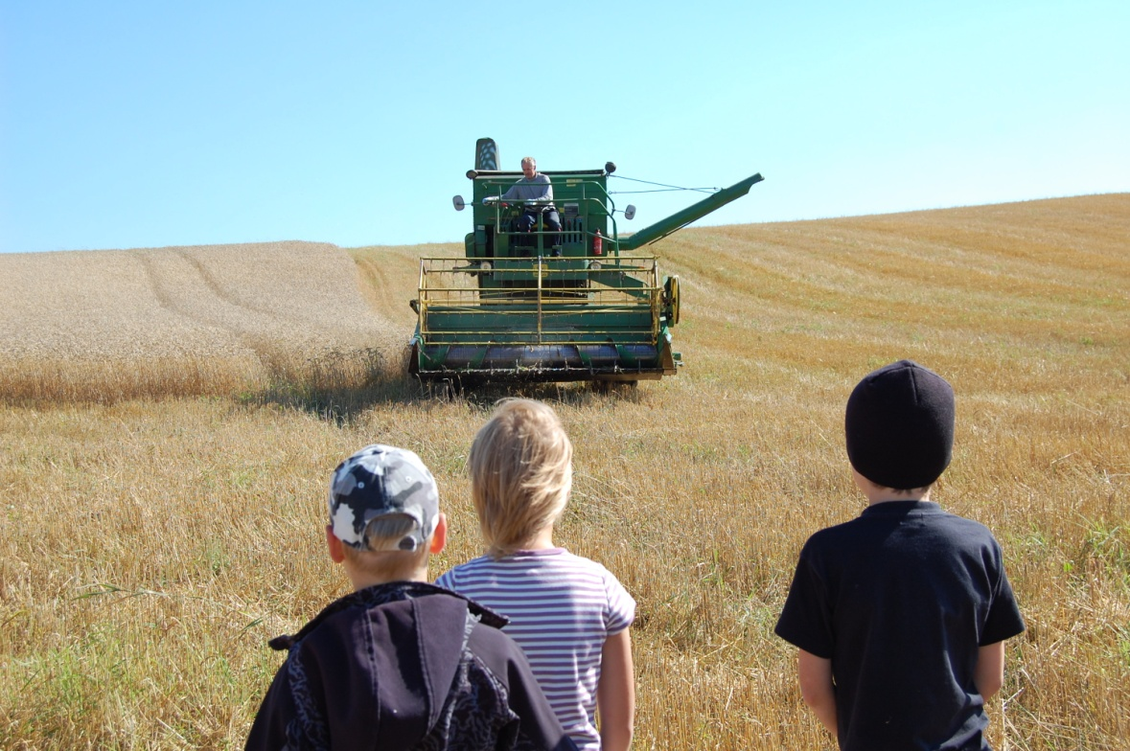
9. Where do the Unipiha school children like to learn?
A. Outdoors
B. Indoors

Slide 11
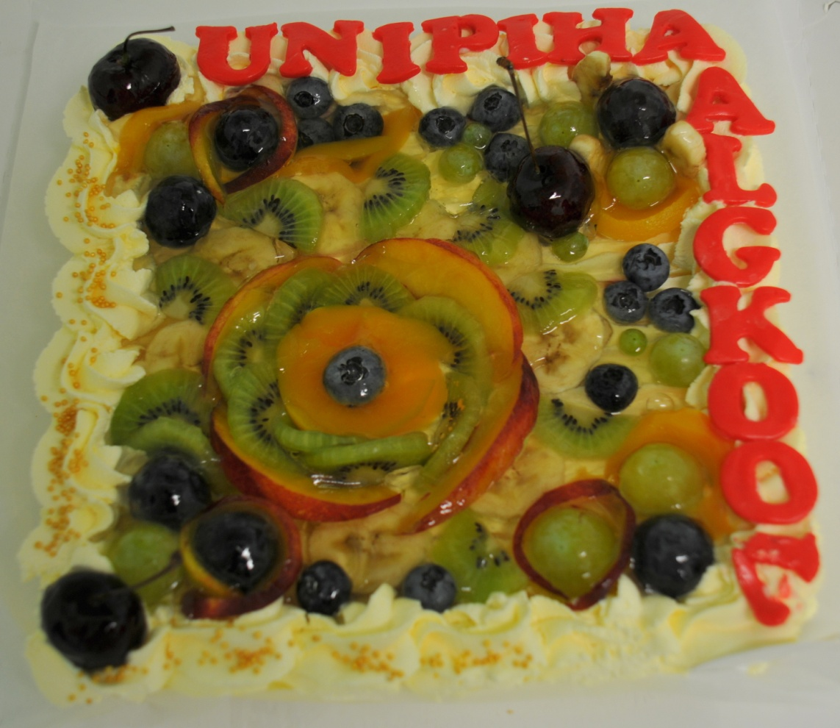
Answers
1) No! But there are brown bears, wolves, lynxes, foxes etc in our forests.
2) B
3) B
4) 2,4,5.
5) Rakvere
6) Arvo Pärt
7) 3, south-east
8) A, 18 pupils
9) A, outdoors

