Slide 1
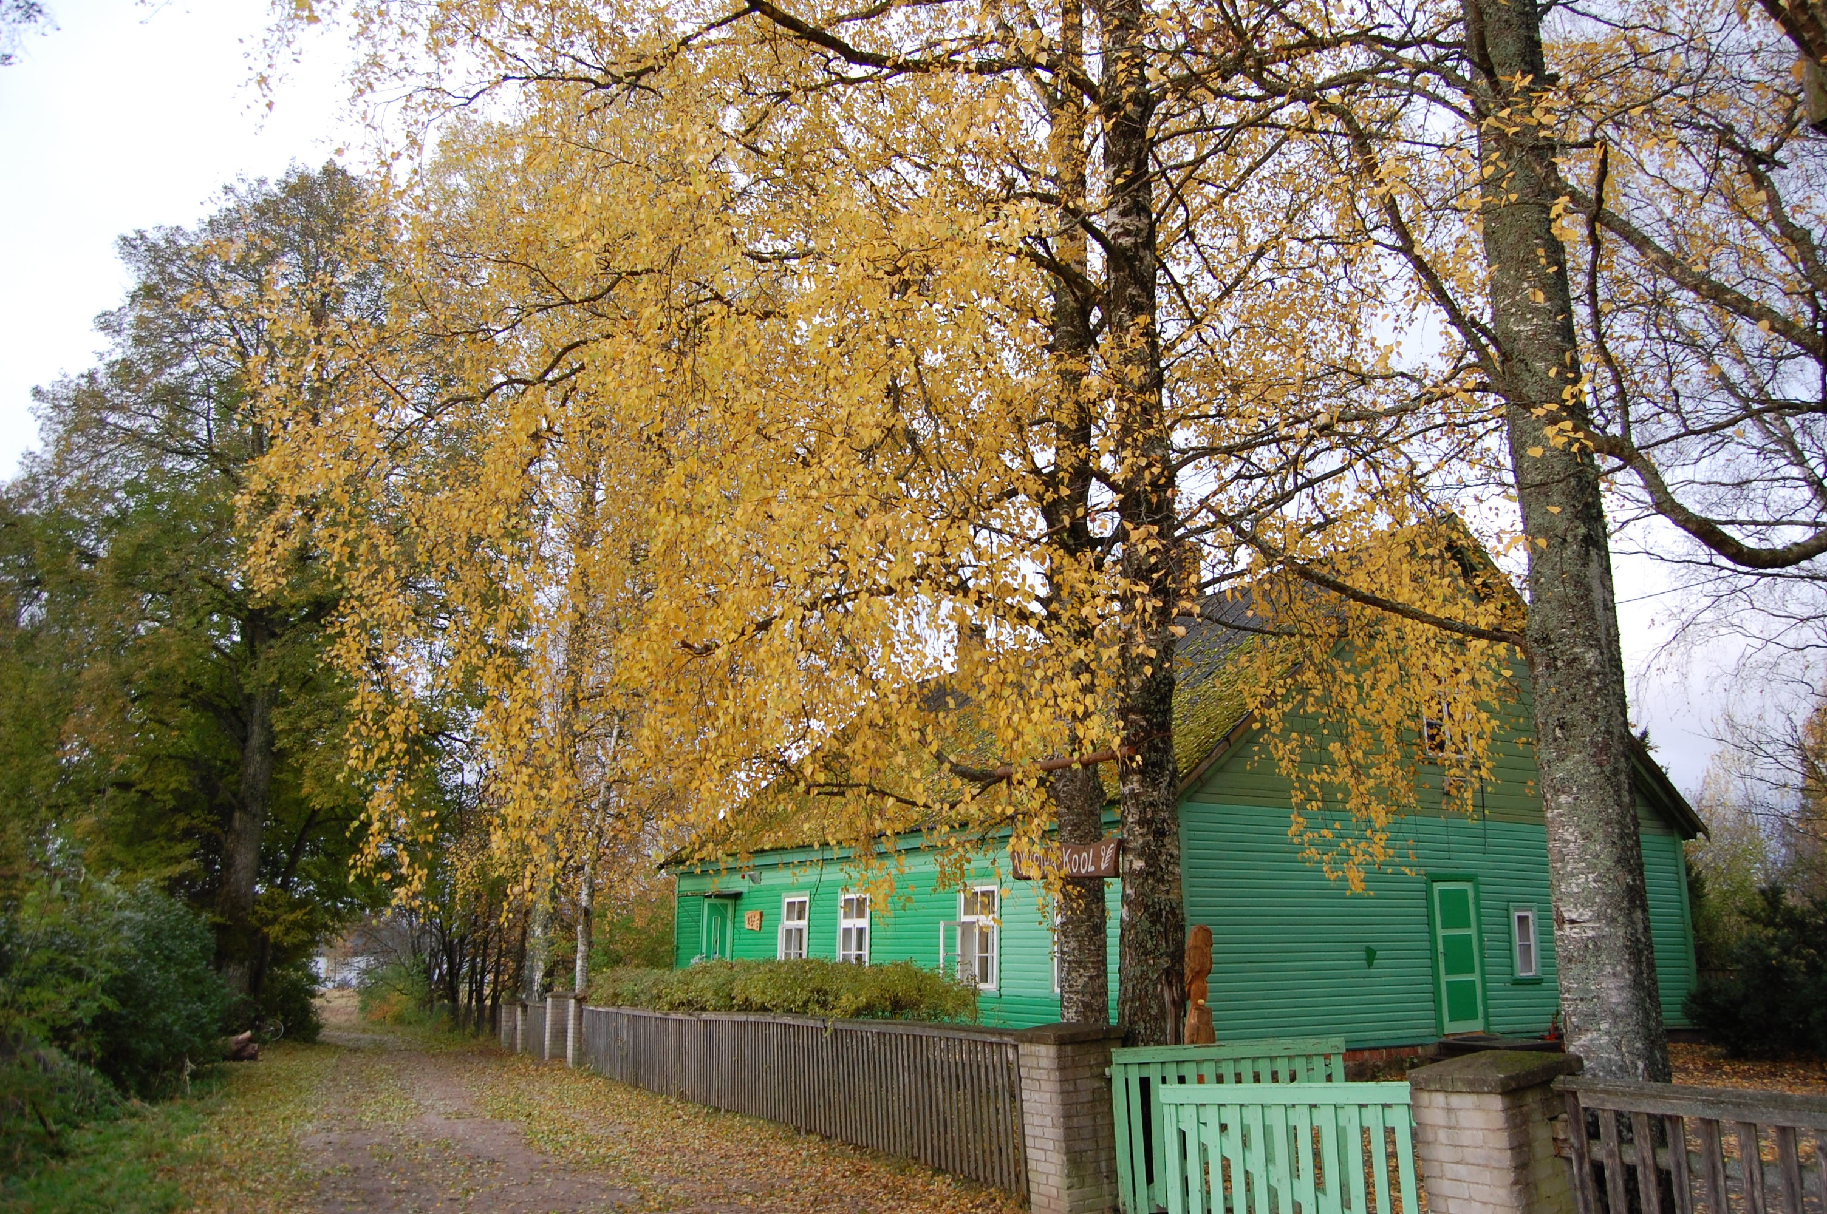
Unipiha Primary School
Estonia
Erasmus
art@creativity
2015

Slide 2
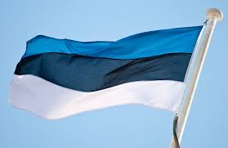
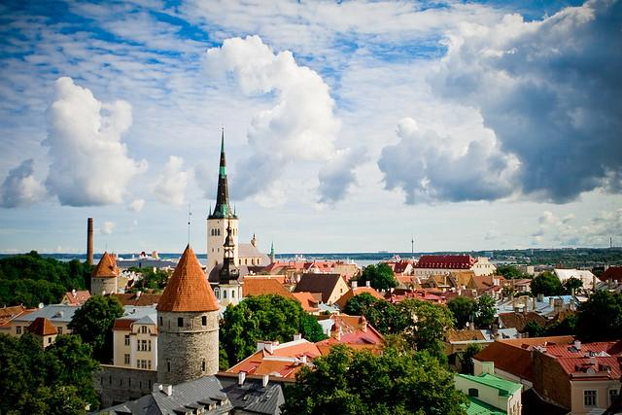

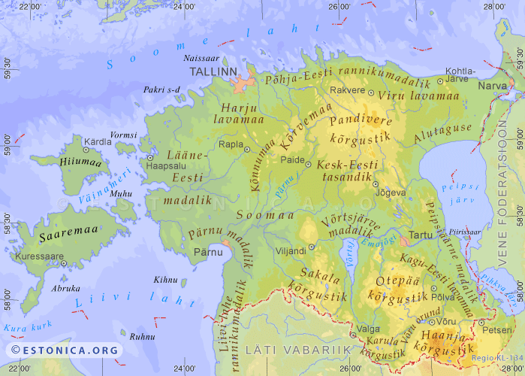
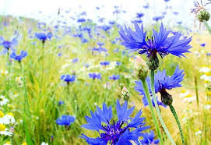
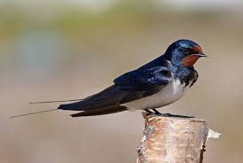
Shortly about or country
Tallinn – our capital city
The national flower – cornflower.
45 339km²
1,3 mil people
The national bird- swallow.

Slide 3
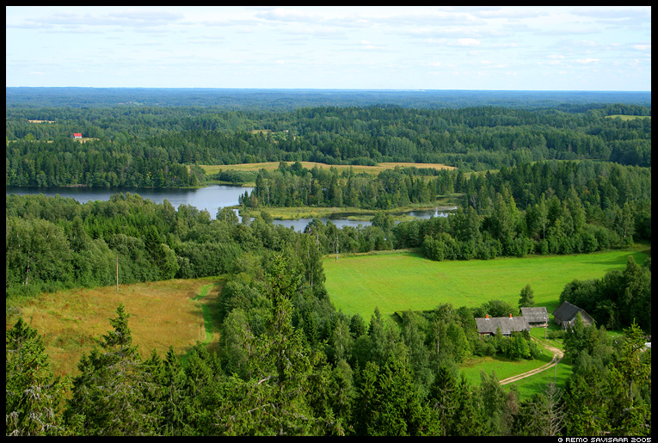
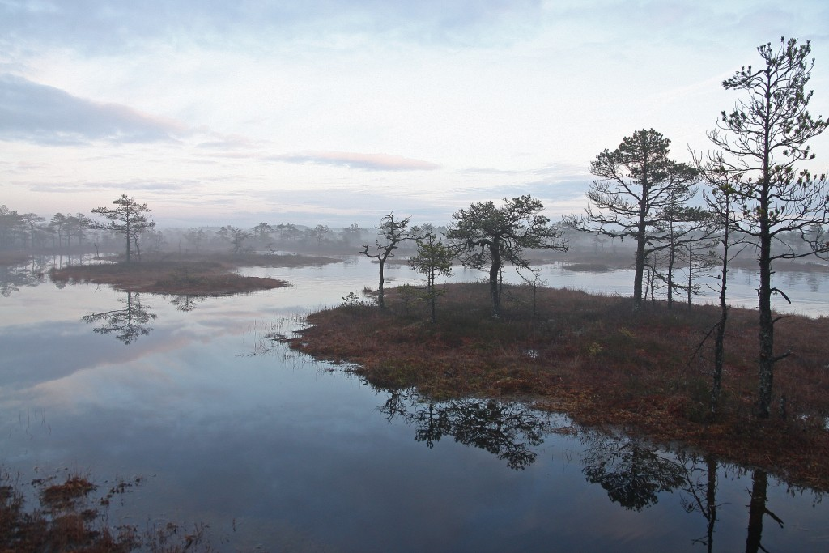
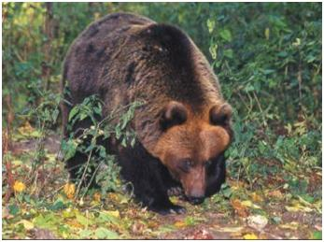
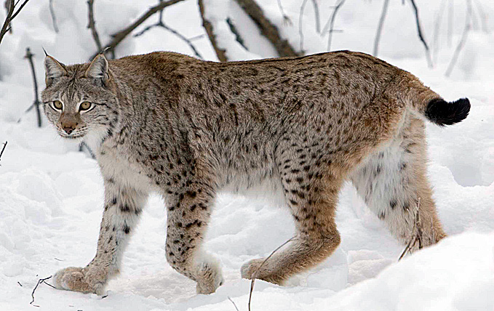
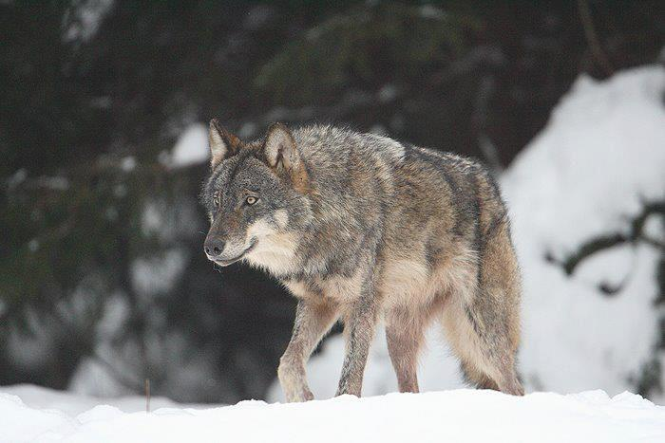
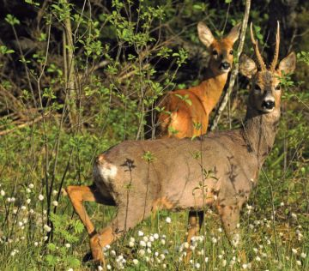
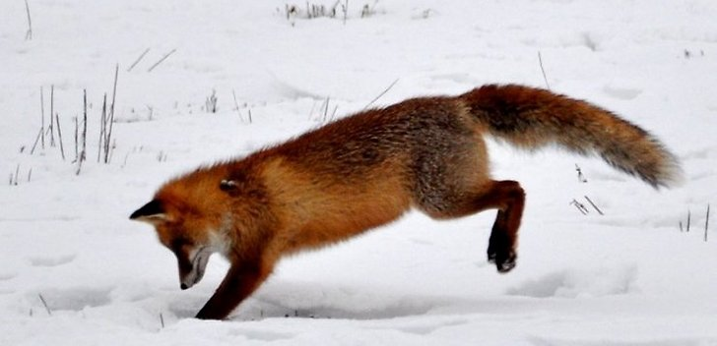
Estonia is covered …..
50% by forest
20 % by marshland
It means we have the significant wildlife.

Slide 4
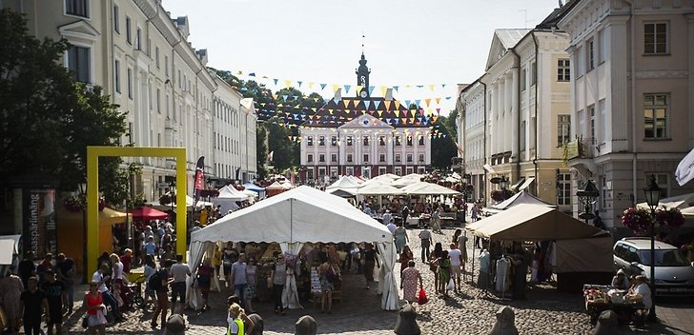
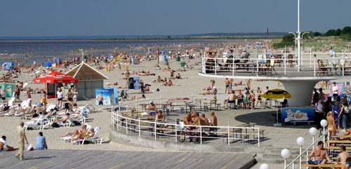
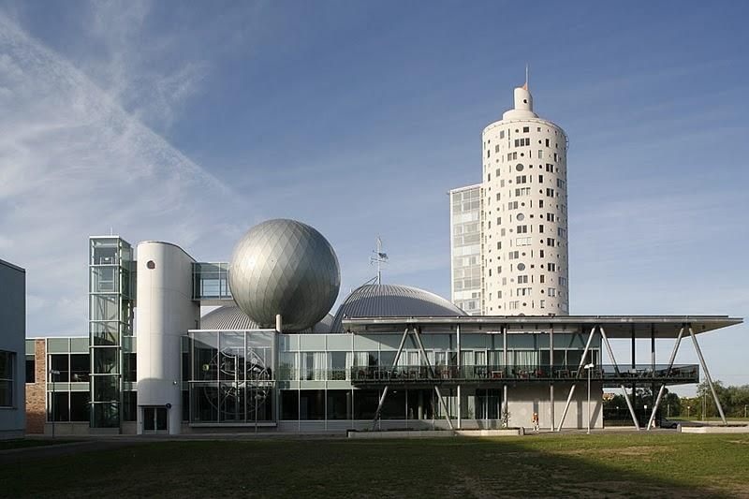
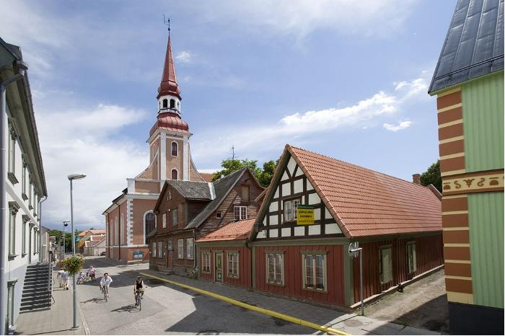
Some towns
Tartu – the town of the old university (1632)
Pärnu – the resort of nice sandy beaches

Slide 5
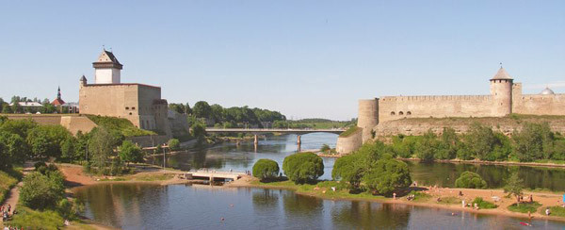
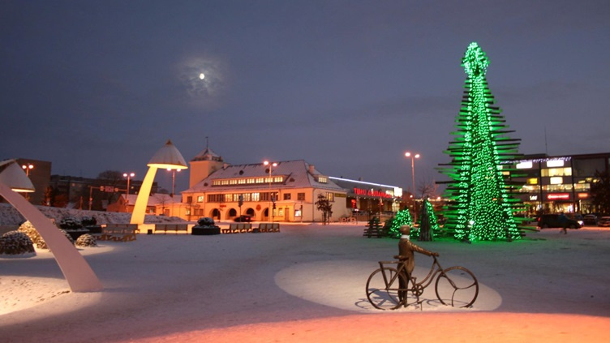
Some towns
Narva
Rakvere
Narva is our border town. To the right (east) you can see the Russia. The Narva river is the border between two countries.
On 2014 designed Christmas tree.
The statue “A boy with the bike listening music” is dedicated to Arvo Pärt, our world famous composer. He lived here.

Slide 6
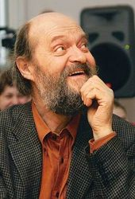
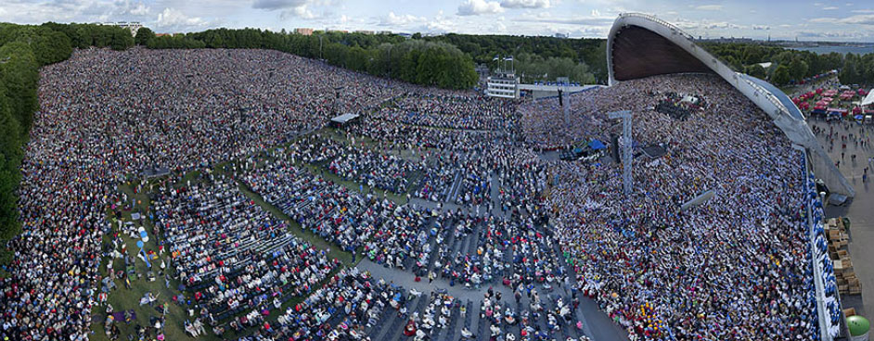
Music
In every 5th year Estonian people come together to Tallinn to sing and dance. There are about 100 000 people as audience and 30 000 singers under the arc of stage at the festival field. Singing together has been an emotional bond between the people and it helped us when we completed our “singing revolution” on 1990.
Arvo Pärt
Arvo Pärt Aliinale:
https://youtu.be/t36Vos4WrpM
https://youtu.be/gcmN0ybQa8w
Arvo Pärt Vater Unser
Songfestival
https://youtu.be/1IKqnO18ZVc
Folkdance festival
https://youtu.be/JPKOXbK8LbY

Slide 7
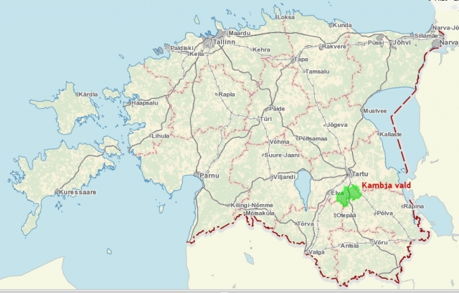

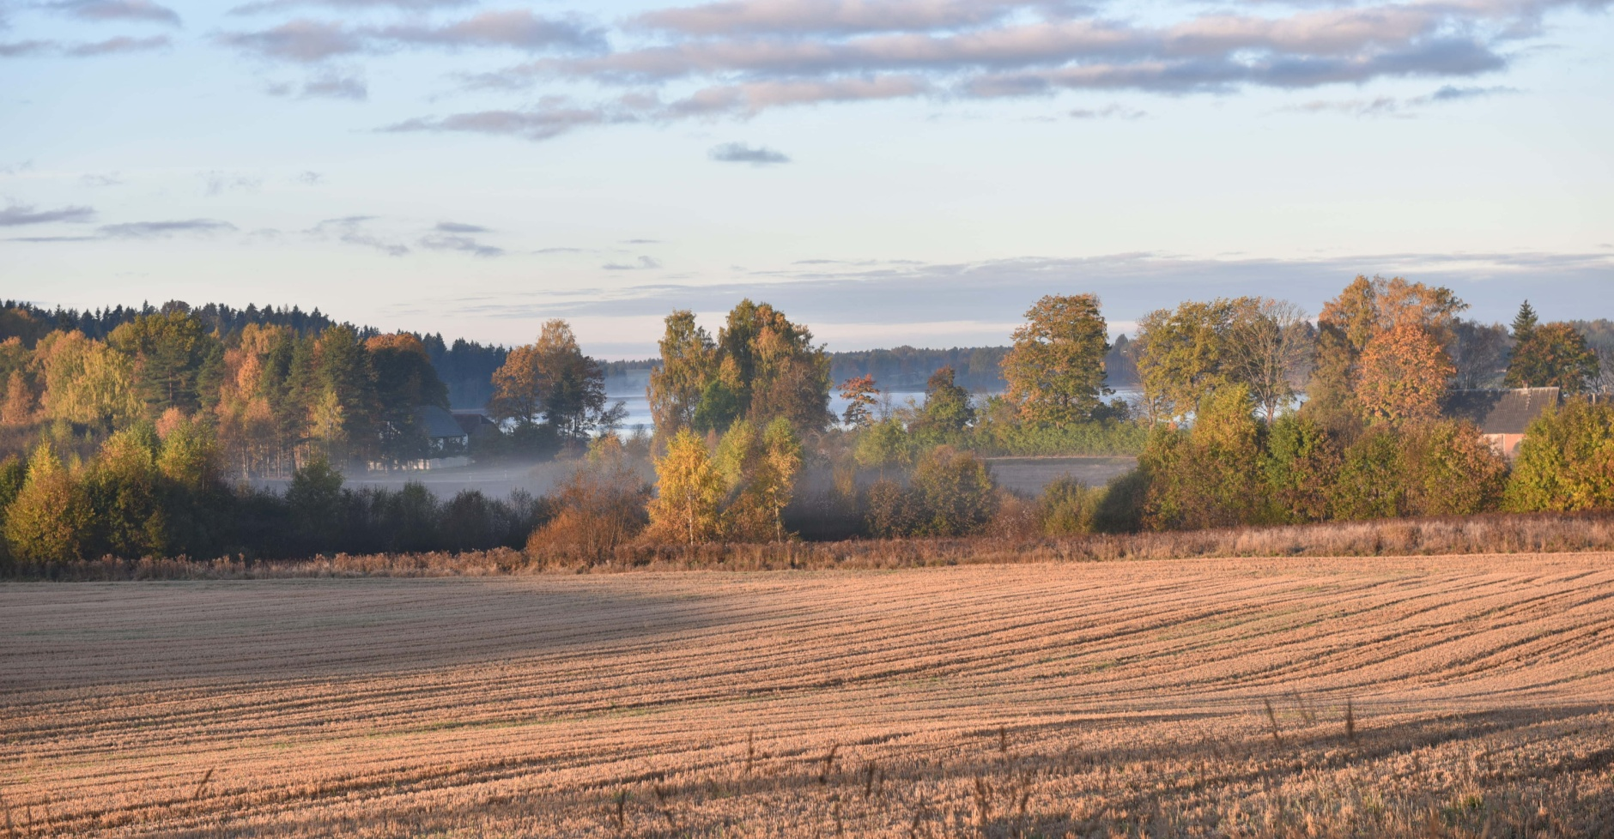
Where do we live?

Slide 8
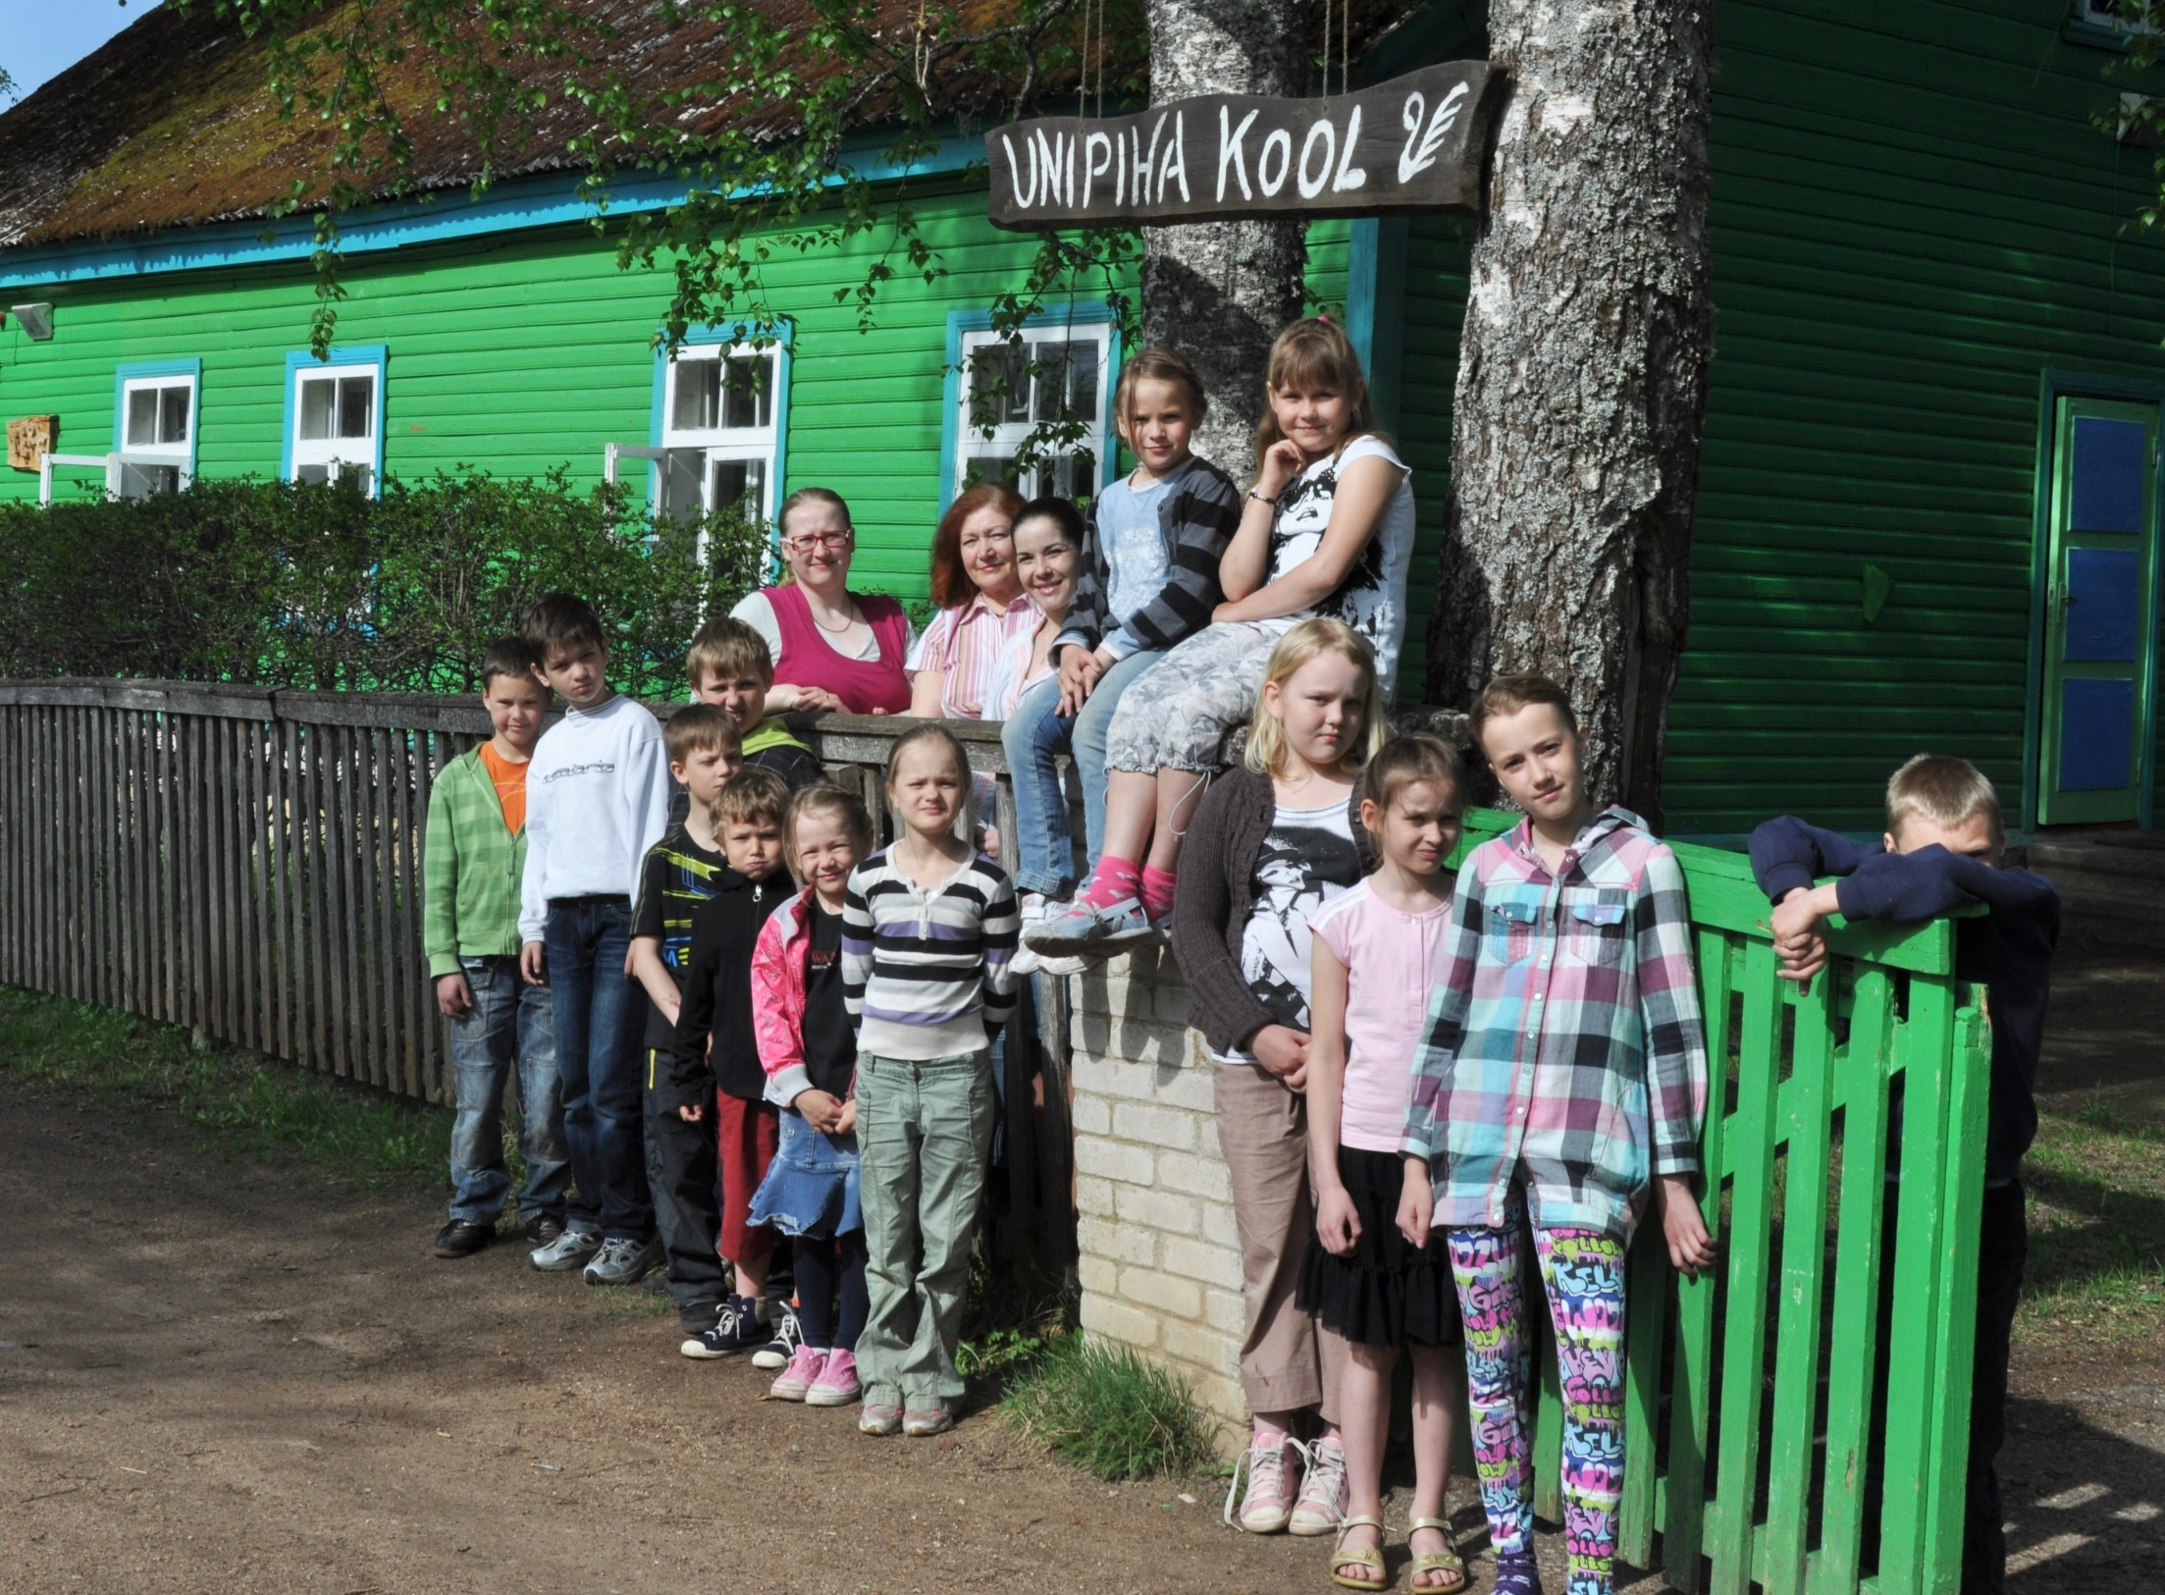
18 pupils /age 7-11
two classrooms
2 classteachers
1 music teacher

Slide 9
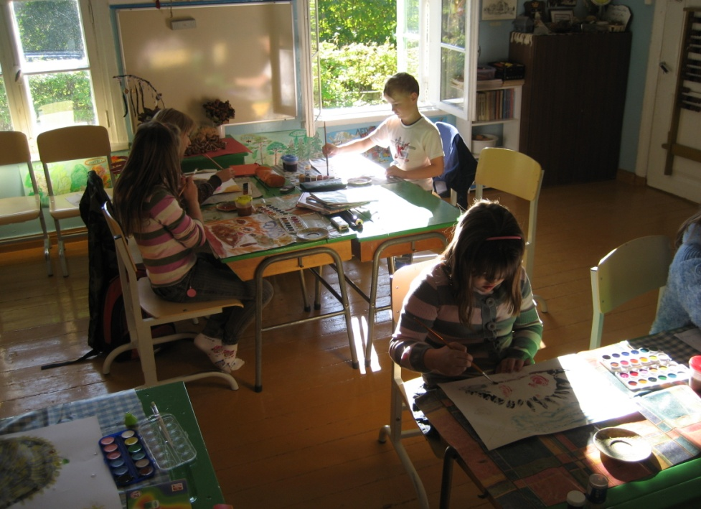
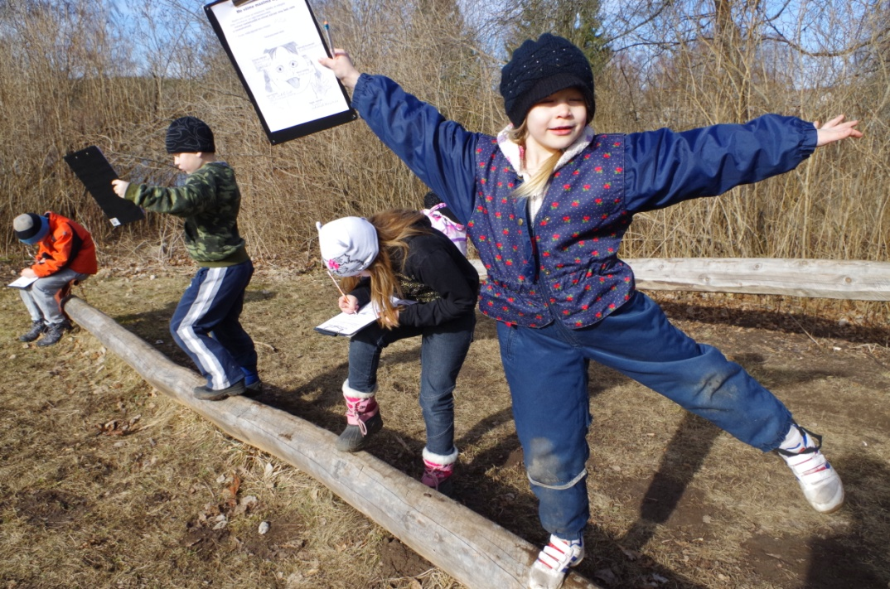
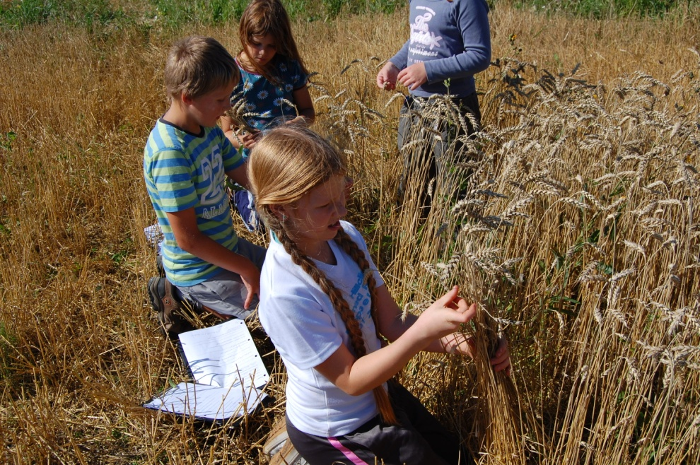
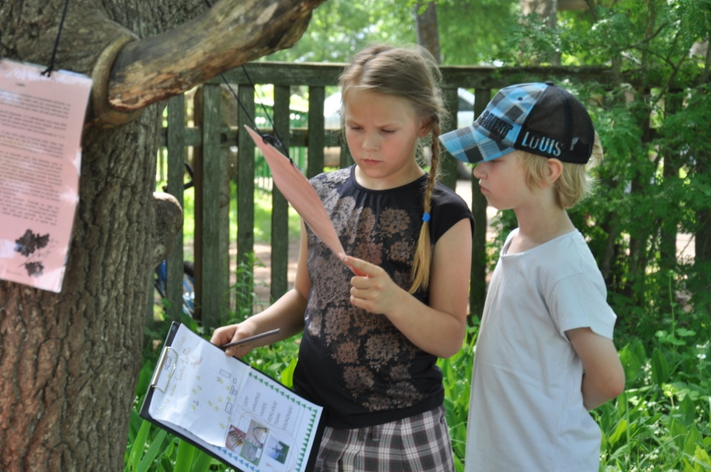
Beside of the traditional learning we make outdoor lerning.

Slide 10
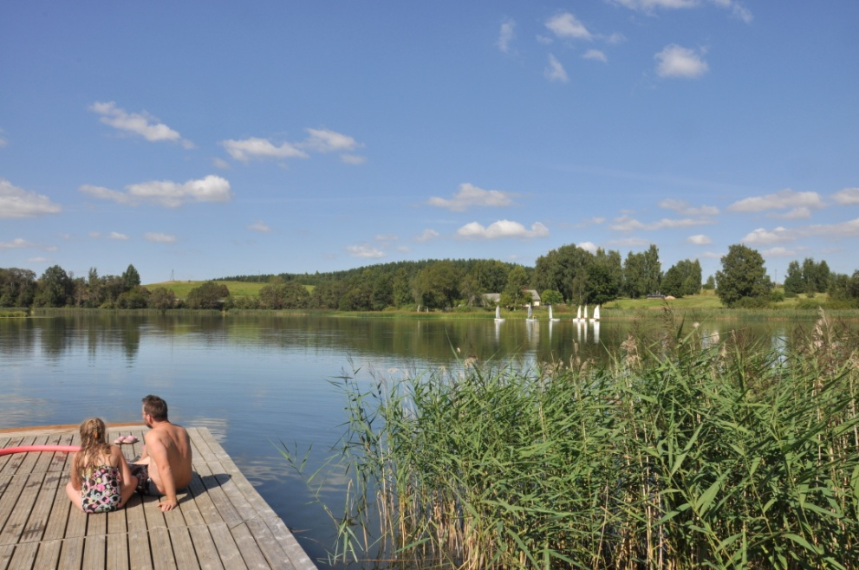
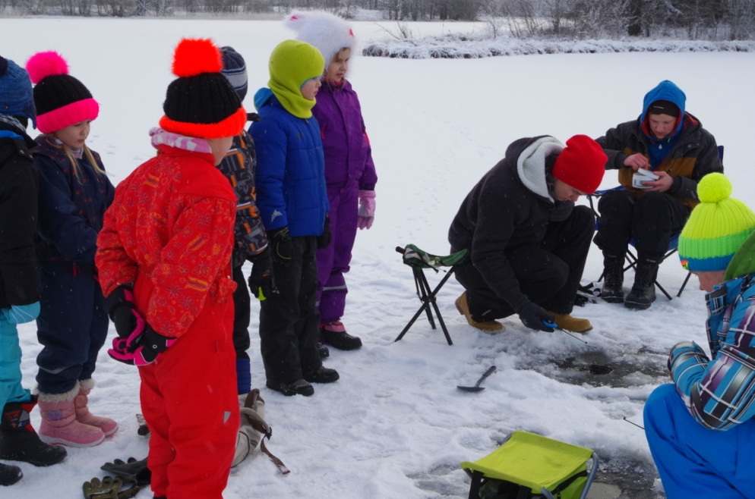
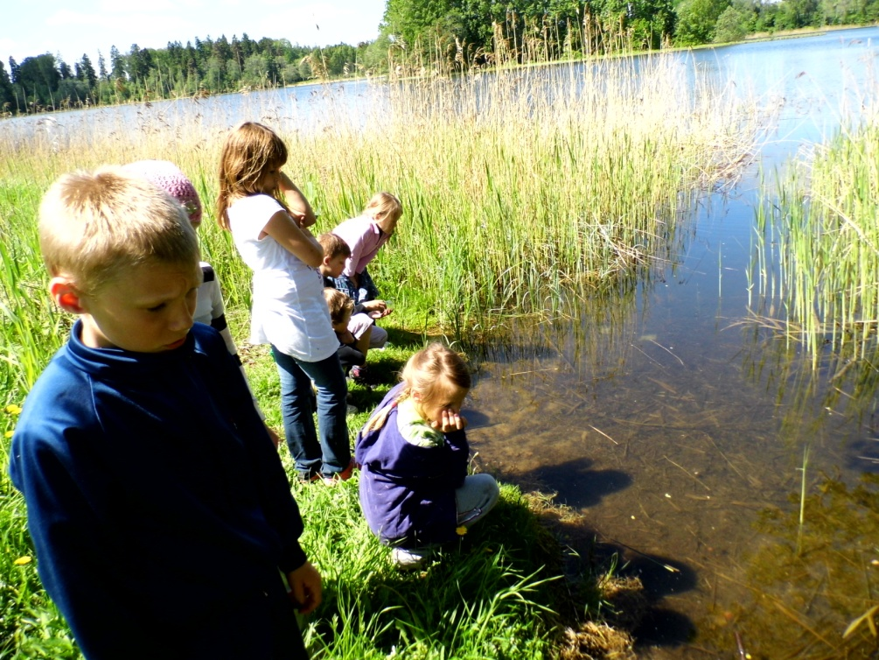
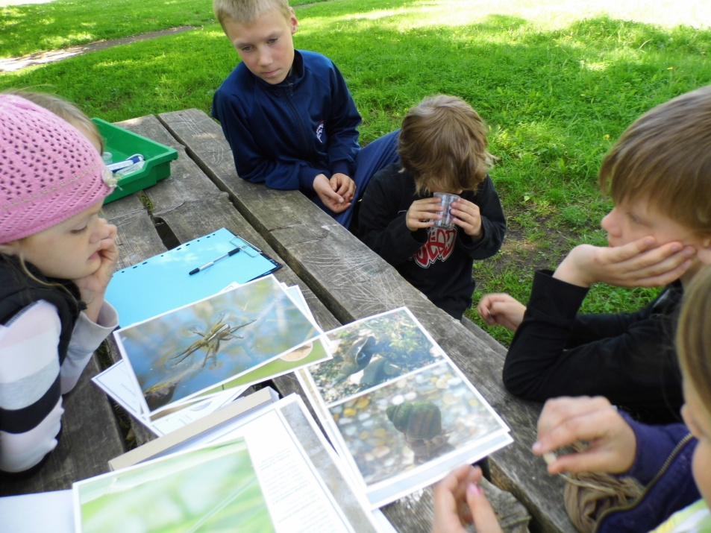
We have a lake just by the school

Slide 11
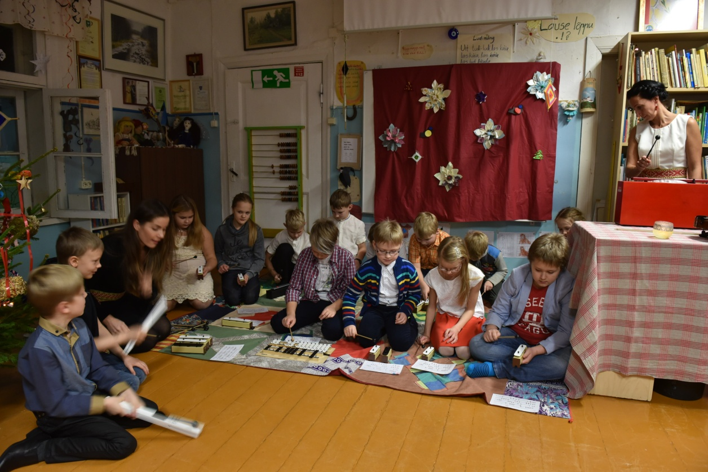
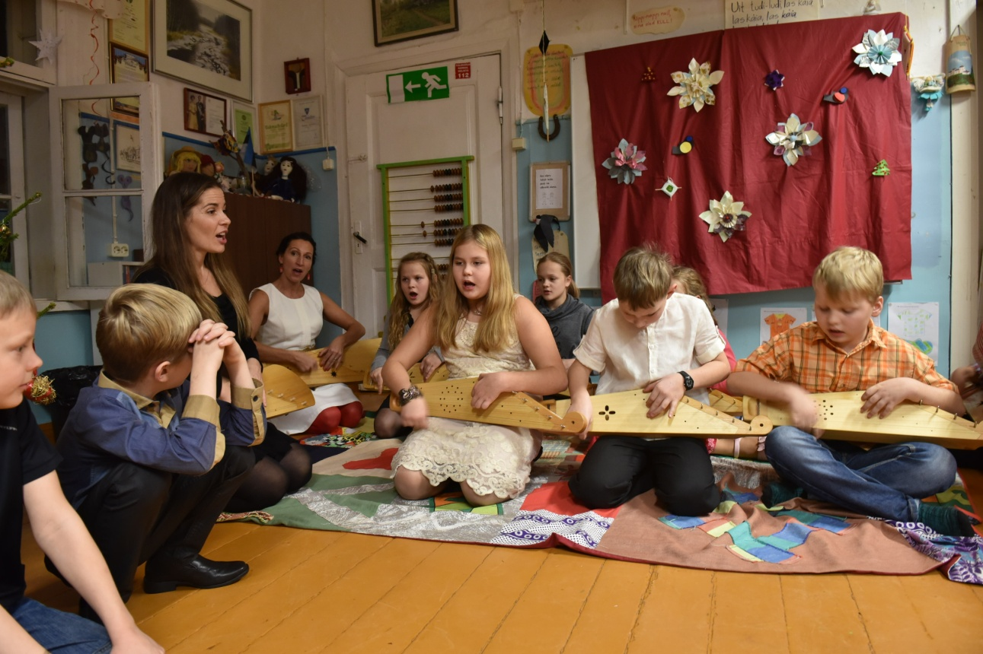
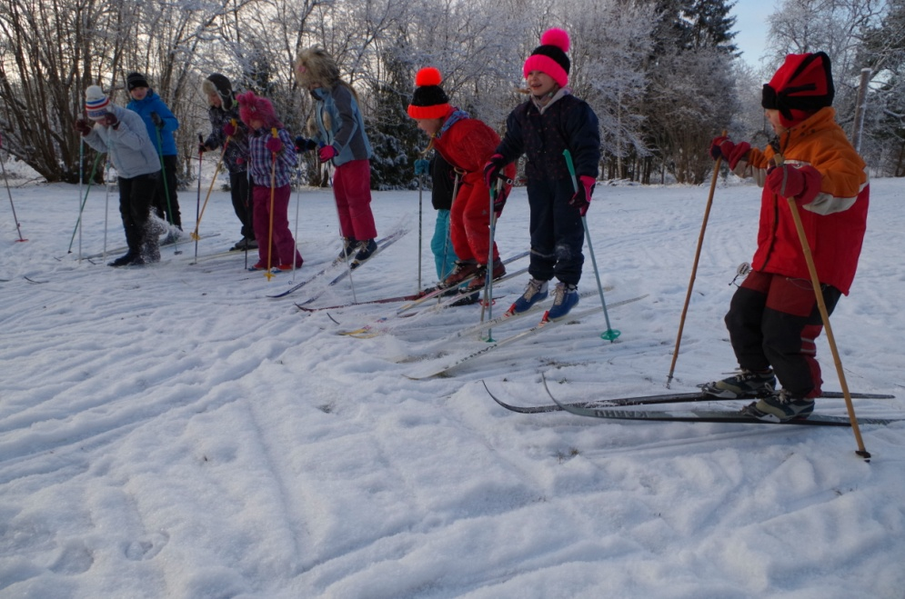
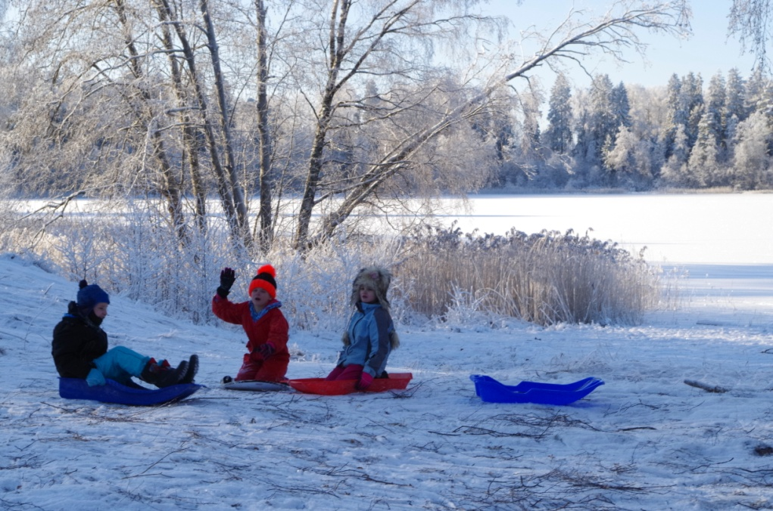
We play music and sing.
We ski and sledge.

Slide 12
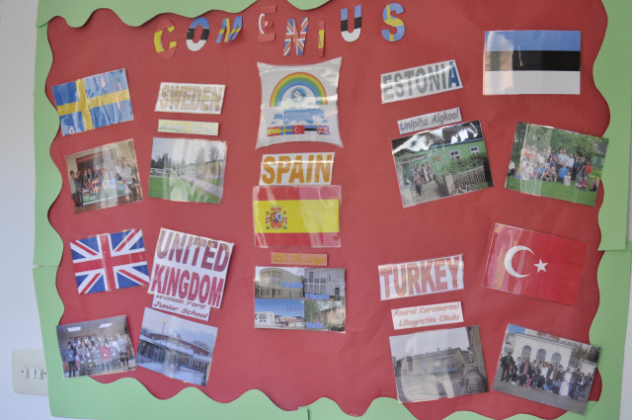
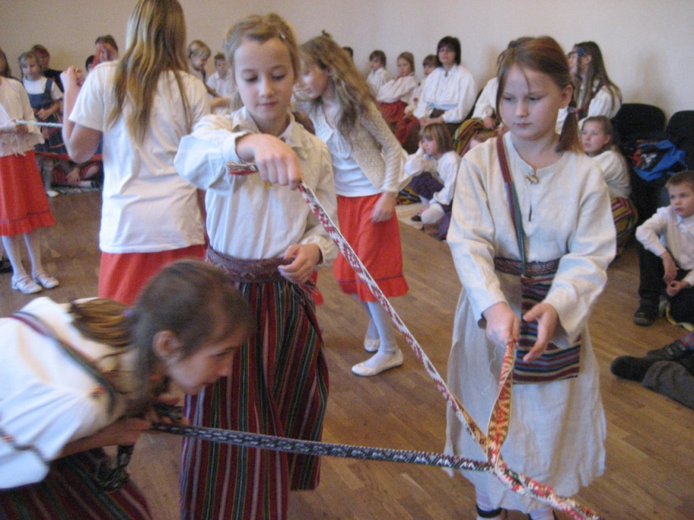
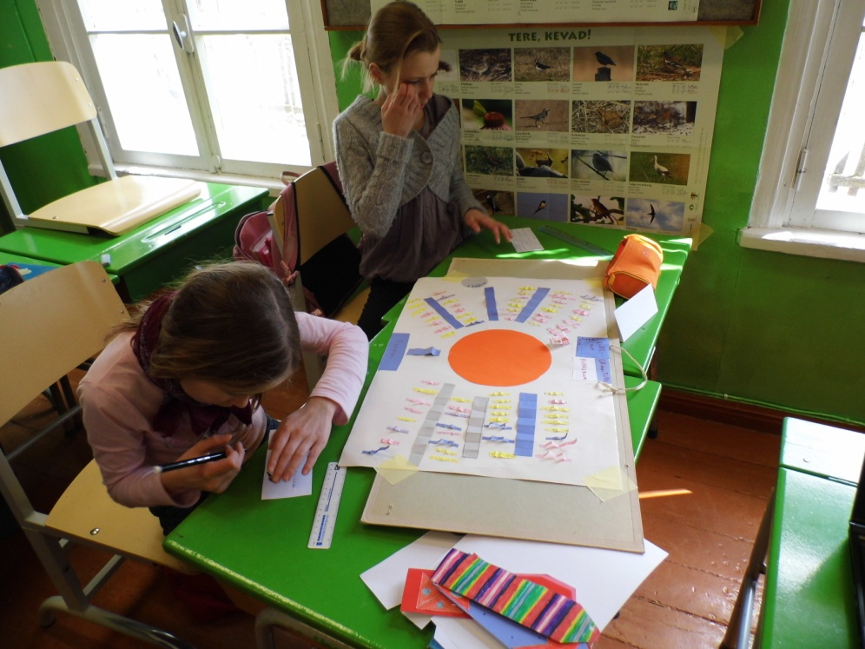
We have had three long Comenius projects:
Bridges
Culture Connects Children
Storyline

Slide 13
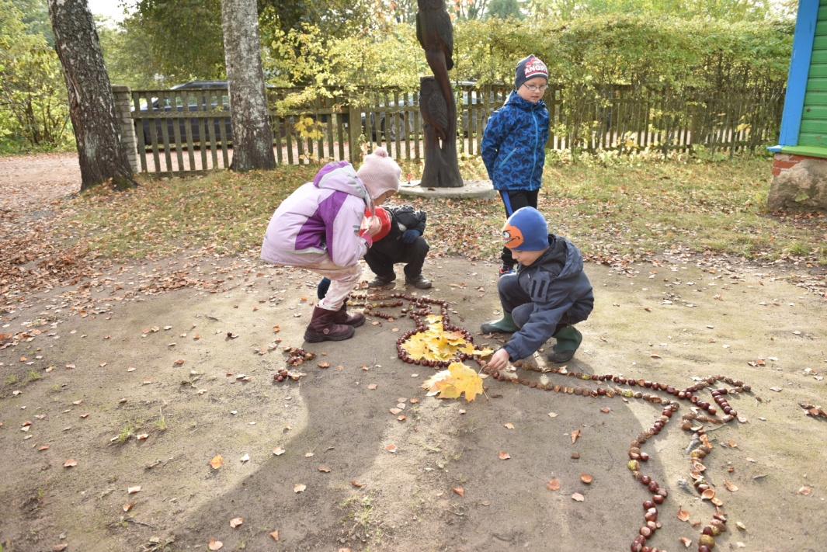
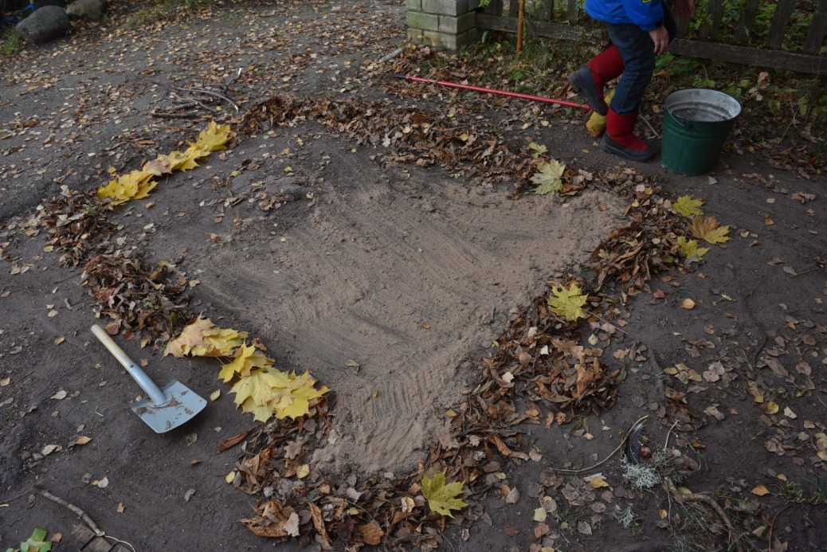
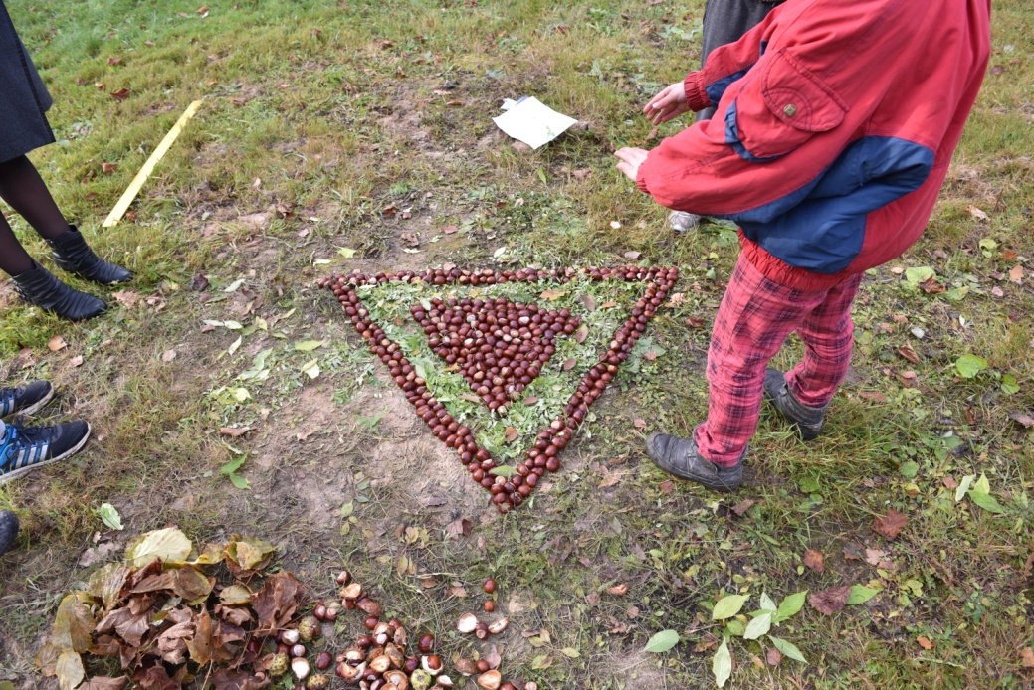
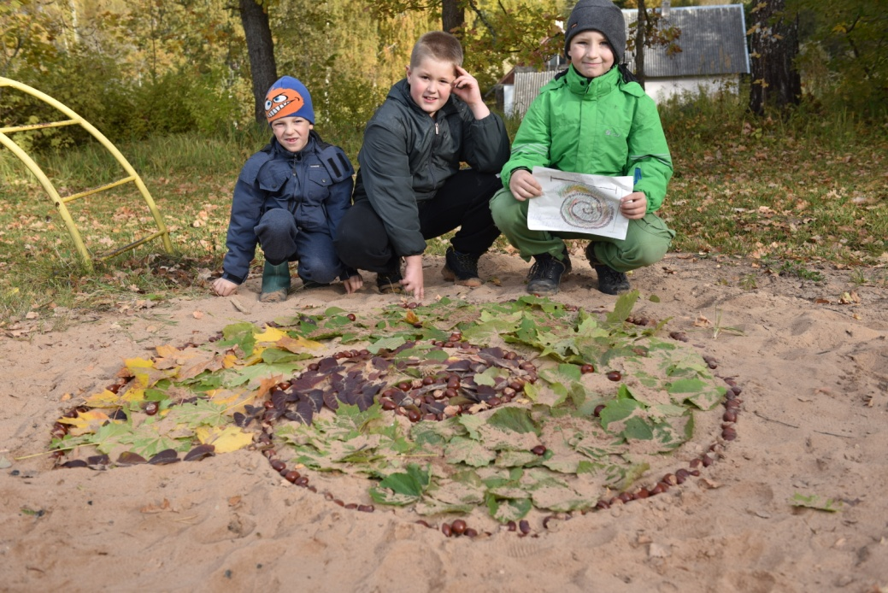
Landart for Erasmus project

Slide 14
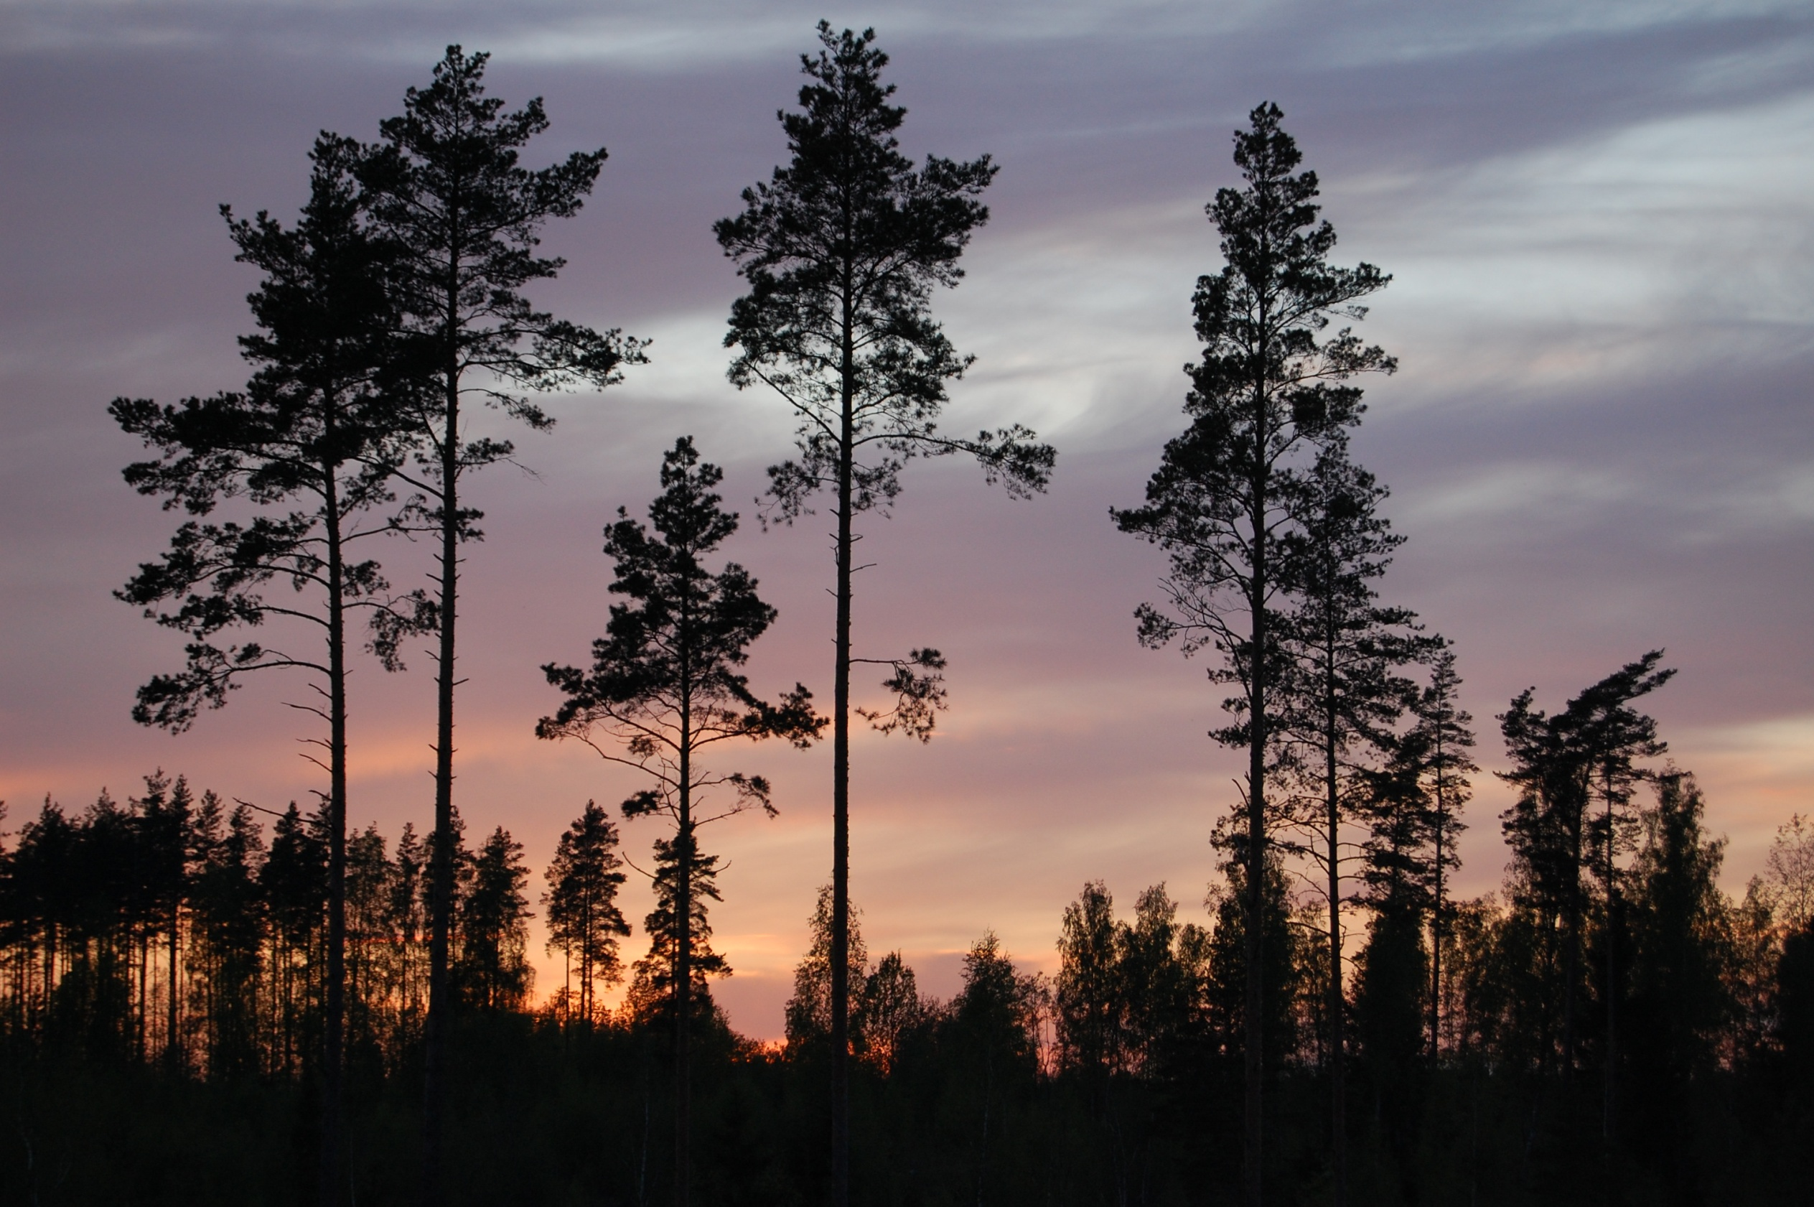
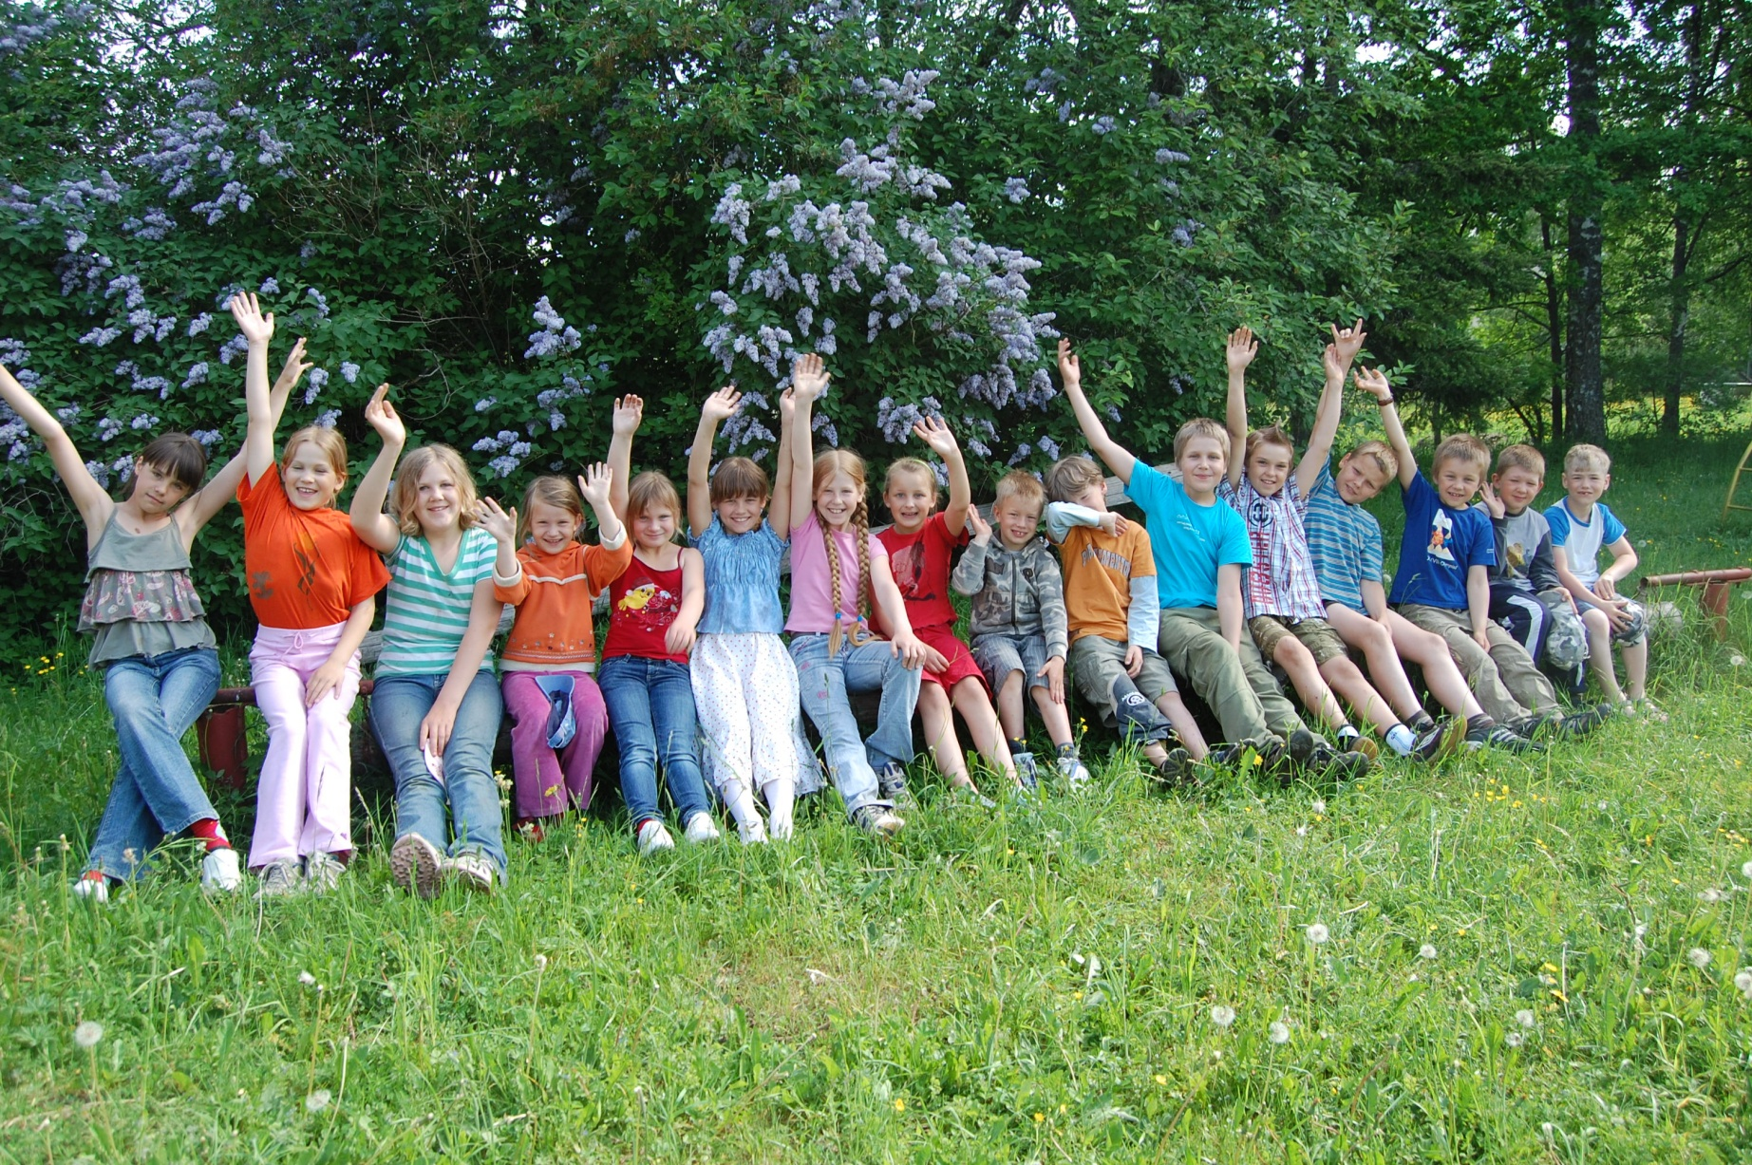
Greetings from Estonia!

